Slide 1
Lesson Objective: To be able to estimate.

Slide 2
Estimation Quiz
Question 1.
Draw a line without using a ruler that is approximately 5cm long

Slide 3
Estimation Quiz
Question 2.
Estimate how many classrooms there are in this school

Slide 4
Estimation Quiz
Question 3.
Estimate how many teachers there are in this school

Slide 5
Estimation Quiz
Question 4.
If this whiteboard is 1.5m from the floor, estimate the height of the whiteboard.

Slide 6
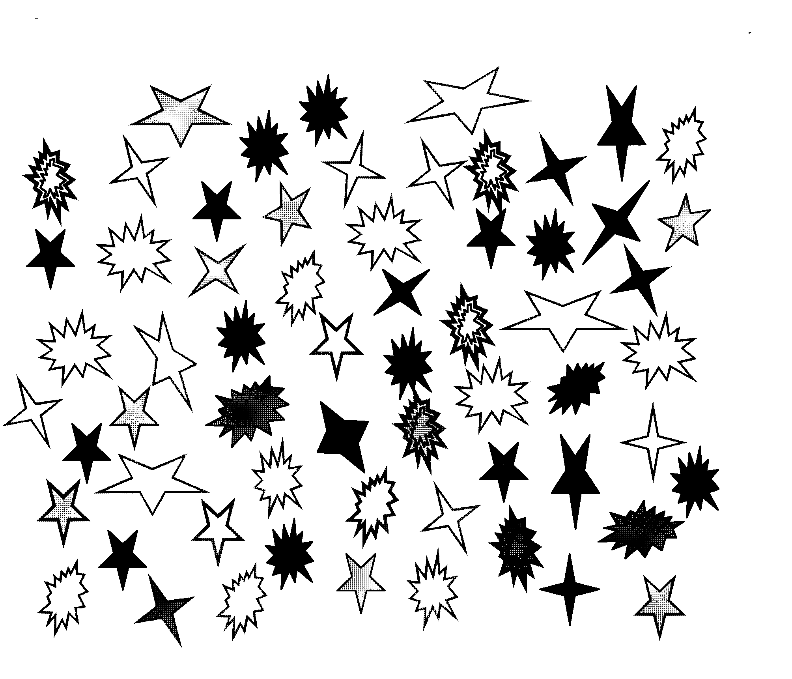
Estimation Quiz
Question 5.
A picture will appear. Look at it carefully
Approximately how many stars were there?

Slide 7
Estimation Quiz
Question 6.
When I say go, close your eyes. Open them when you estimate 60 seconds have passed. Make a note of the letter you see on the screen.
C
A
B
D
E
F
G

Slide 8
Estimation Quiz
Question 7.
Estimate my height in centimetres

Slide 9
Estimation Quiz
Question 8.
Draw a square that has an approximate area of 9 square centimetres

Slide 10
Estimation Quiz
Question 9.
Draw an angle that is approximately 45 degrees

Slide 11
Estimation Quiz
Question 10.
A picture will appear. Look at it carefully
Approximately how many footballs were there?

Slide 12
Estimation Quiz
Question 11.
Estimate how many questions there will be in this quiz.

